Slide 1
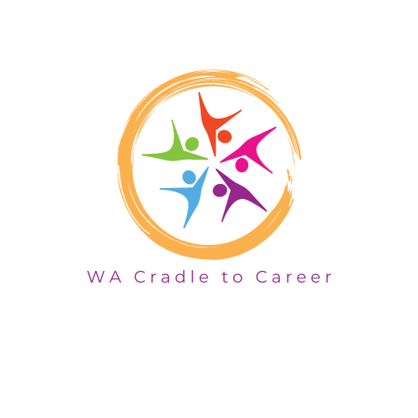



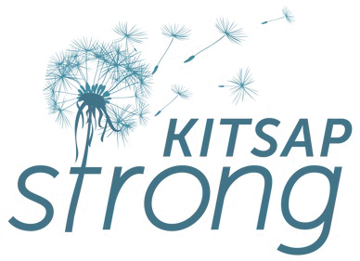
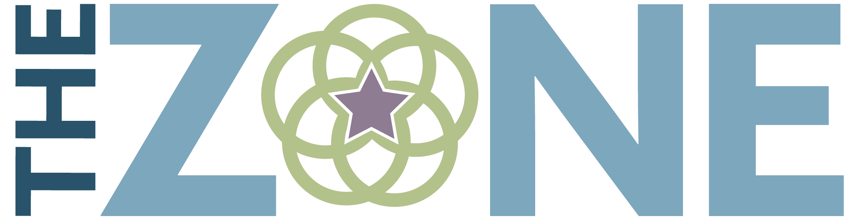
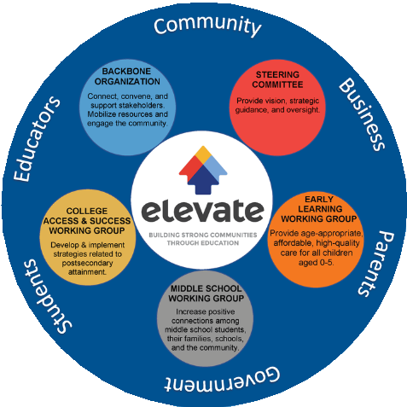

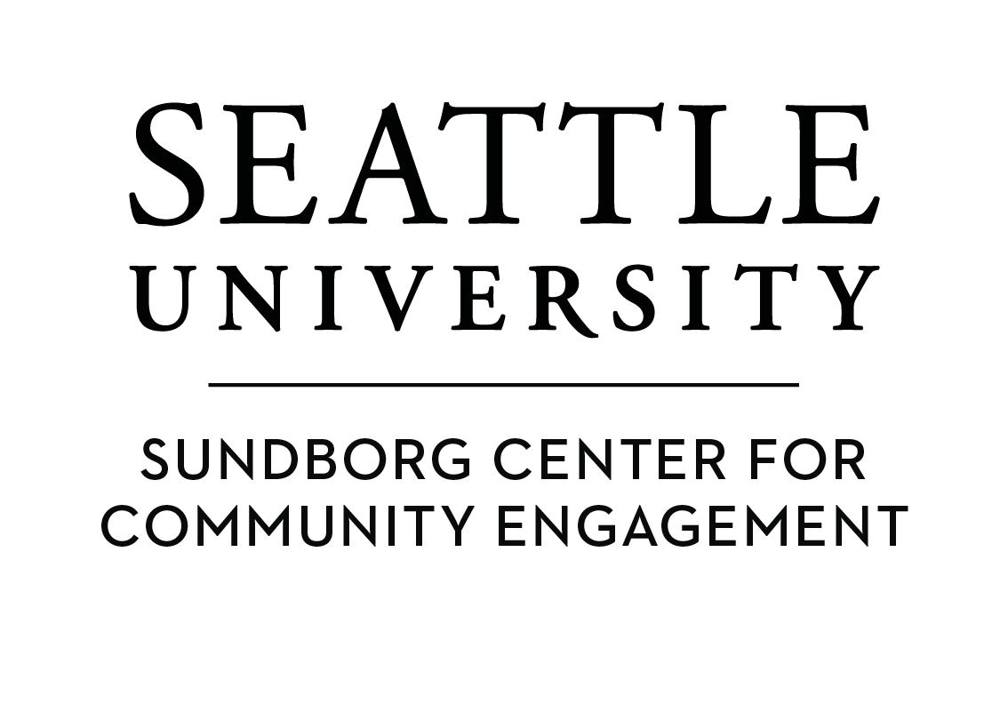
WAC2C
is a partnership of cross-sector, place-based organizations dedicated to ensuring all communities in Washington have the civic infrastructure necessary to provide equitable pathways for youth to succeed in education, career, and life.
We intentionally provide place-based, language and culturally centered approaches to foster trust,rapport, and access to resources. Equitable systems and partnerships that mindfully allocate resources needed for communities to thrive in the lower Yakima Valley.
The Renton Innovation Zone Partnership’s (RIZP) mission is to lead a relation-
ship-based, data-informed collaborative network to advance racial equity and create healthy learning opportunities for all children throughout the Renton Innovation Zone.
The ZONE is a community initiative, building hope and opportunity through collective action in the neighborhoods of Northeast Spokane.
A Collective's Common Agenda
To improve the well-being and education- al attainment of Kitsap residents, through a focus on empowerment and equity, the prevention of adverse childhood experiences (ACEs), and the building of resilience.
Elevate is a community partnership of diverse, cross-sector members working collaboratively and leveraging resources in order to strengthen the educational pipeline, from cradle through career. The partnership’s goals are outlined in the Common Agenda, and our work is guided by shared values.
Today, Graduate Tacoma is more than 350 community partners strong. We are parents and educators, early learning and higher education, business and labor, youth and community service, civic and philanthropy, local government and communities of faith, all aligning our work together with Tacoma schools to impact student success.
To empower community leaders, foster connections, and support East King County by collaborating, convening, researching, and providing training and resources to partners dedicated to improving systems intergenerationally.
The Sundborg Center for Community Engagement connects campus and community to promote a more just and humane world.

